Slide 1
Make your model a function
DARTH workgroup
December 7th

Slide 2
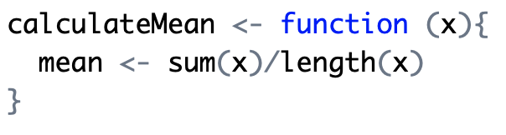
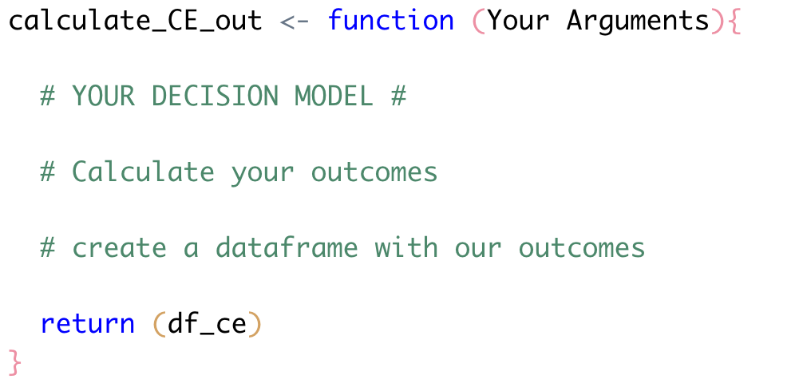
Functions in R
Created to repeat a calculation several times in the exact same way

Slide 3
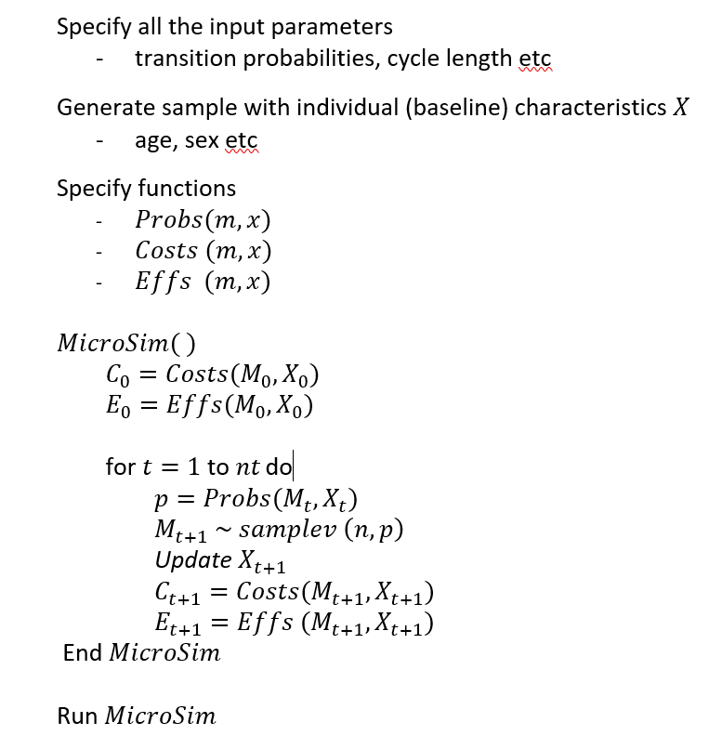
Remember: Structure of our code
NOTE: old coding convention
Notes:
Tell the students that they can click on the links and this will direct them to the specific parts of the code.

Slide 4
Remember: Structure of our code
NOTE: old coding convention
Wrap it in a function
Notes:
Tell the students that they can click on the links and this will direct them to the specific parts of the code.

Slide 5
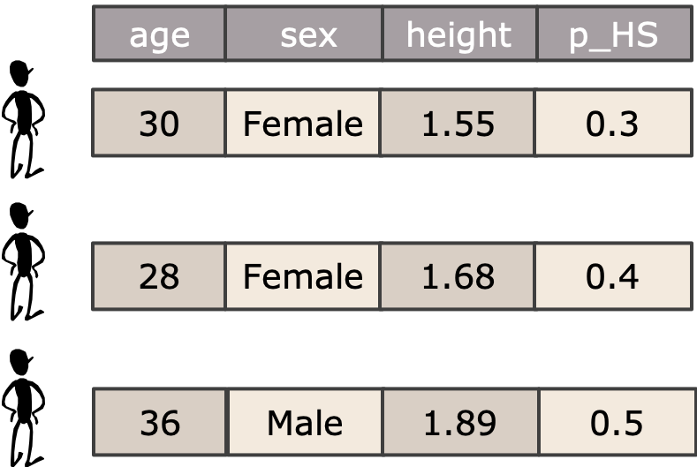
Input
Data
Population characteristics and model parameters
x₁
x₂
$$⋮$$
x_{j}

Slide 6
Input
Data
Population characteristics and model parameters
x₁
x₂
well
$$⋮$$
sick
dead
Patient 1
x_{j}
Patient 2
Patient i
well
sick
dead
Model

Slide 7
Input
Data
Population characteristics and model parameters
Outputs
x₁
x₂
Effect
$$⋮$$
Cost
x_{j}
well
NMB
sick
dead
Model
NMB: Net monetary benefit

Slide 8
Input
Data
Population characteristics and model parameters
Outputs
x₁
x₂
Effect
$$⋮$$
Cost
x_{j}
well
NMB
sick
dead
Model

Slide 9

Input
Data
Population characteristics and model parameters
Outputs
x₁
x₂
Effect
$$⋮$$
Cost
x_{j}
well
NMB
sick
dead
Model

Slide 10
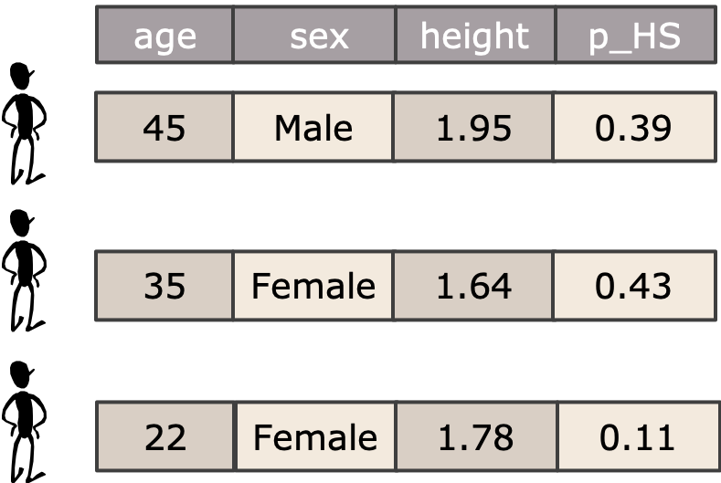
Input
Data
Population characteristics and model parameters
Outputs
x₁
x₂
Effect
$$⋮$$
Cost
x_{j}
well
NMB
sick
dead
Model

Slide 11
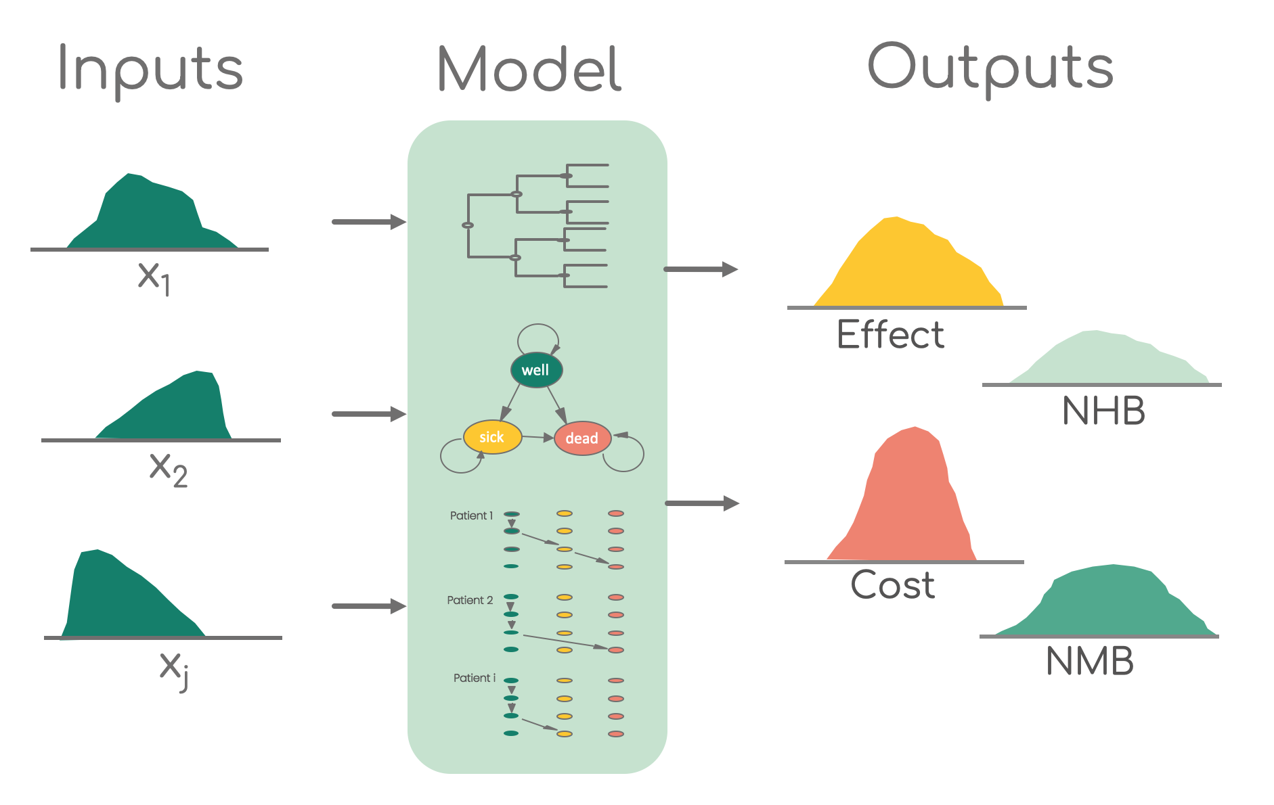
PSA & R
Function which runs the model
using the parameter values from the list
List or data set with parameter
values for each iteration
Data frame with model outcome estimates for each iteration

